Slide 1
Austin as a Welcoming City: Local Responses to Federal Immigration Policy Center for American Progress
Tom Jawetz
Vice President, Immigration
April 13, 2018
Notes:
Thank you very much for inviting me to participate in this event. It’s a treat to be on an Opportunity Forum panel moderated by Denise Gilman, because Denise provided me with my first opportunity to work professionally in the field of immigration law and policy almost 15 years ago when I worked as her fellow at the Washington Lawyers’ Committee.
My name is Tom Jawetz and I lead the immigration policy team at the Center for American Progress in DC. The Center for American Progress, or CAP, is an action-oriented think tank. As a national organization we do not typically direct local campaigns, but I think some of the best work that my team does involves identifying the key pieces of data or analysis that are needed to shape the conversation in a particular debate and breaking that information down to the state, local, and congressional-district level so that it can be picked up and used to promote positive change.
We are going to have a robust discussion today about local responses to federal immigration policy, but to set the stage for that conversation I was asked to talk broadly about why this matters and what's at stake. What's at stake for communities at large and how does that drive the decisions of local officials to adopt laws and policies in this space.
Throughout my remarks I will look at this issue through various lenses—the economy, major industries, public safety, child welfare—and where possible I hope to speak about these issues nationally and with respect to Texas specifically. My remarks will look at the immigrant population in this country from different perspectives, so I will begin with a look at undocumented immigrants broadly, then look at two populations whose lawful status in this country is now in jeopardy—people with DACA, Deferred Action for Childhood Arrivals, and people with Temporary Protected Status. I will also touch on refugees who have been resettled in this country and—because the immigrants are so well-integrated throughout our society, speak a bit about mixed status families and the impact that some enforcement policies today are having on Latinos broadly and on U.S. citizen children in these households.
I will close by talking about two ways in which this administration is looking to use local law enforcement to ramp up federal immigration enforcement efforts: first, by threatening to withhold critical funds from jurisdictions that have adopted policies designed to strengthen their communities; and second, by inducing cooperation with jurisdictions willing to affirmatively participate in immigration enforcement efforts themselves.

Slide 2
Economic Impacts of Removing Unauthorized Immigrant Workers
Key Estimated Economic Harms for the Nation
$434 billion lost in GDP, annually
A cumulative loss of $4.7 trillion in GDP over the next decade
$900 billion lost in federal revenue over the next decade
Notes:
About 18 months ago, we published a report examining the economic and fiscal impacts of removing the 7 million unauthorized immigrants who are in our workforce. The study found that doing this would have a significant negative economic impact across the nation, state, and all industries.
$434 billion in annual GDP losses and a cumulative 4.7 trillion over the next decade. As a point of reference, the long-run effects on the economy once capital adjusts to the decrease in labor will be about two-thirds of the decline we experienced during the Great Recession 10 years ago. Removing 7 million people from the workforce would actually reduce national employment by an amount similar to that experienced during the Great Recession—all at a time when the country is at or near full employment.
We’re also talking about losing out on nearly $900 billion in federal revenue over the next decade.

Slide 3
Economic Impact on Texas of mass deportation
60.1 billion GDP loss, annually
Industries losing the most (by annual dollar)
Manufacturing: $9.5 billion
Construction: $9.4 billion
Wholesale and retail: $8.8 billion
Construction, Leisure and Hospitality lose more than 10 percent of their sector
Notes:
The impacts on Texas were particularly stark.

Slide 4
Yearly Survey of DACA Recipients (2015-2017) By Tom K. Wong
DACA recipients are better able to fulfill their economic potential – higher wages and better jobs
They contribute more to their local economy and community
94 percent said DACA allowed them to pursue their educational aspirations
Notes:
- In partnership with Tom Wong, UWD, and NILC, we have been producing yearly survey of DACA recipients since 2015

Slide 5
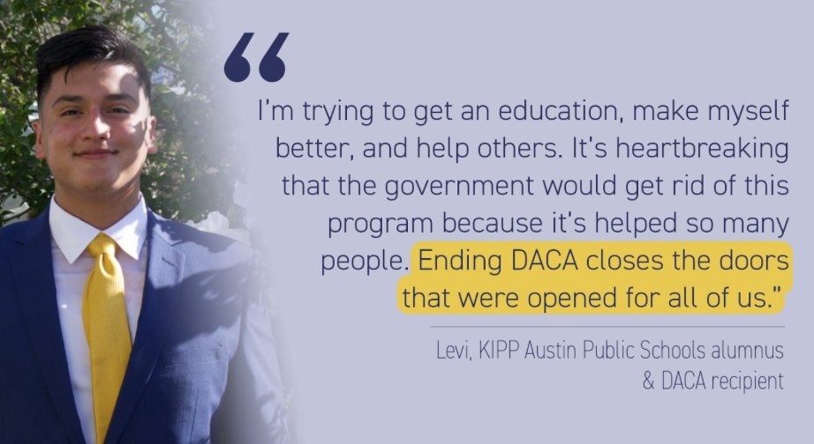
Dream Act – Texas in Focus
125,000 DACA recipients in Texas
306,000 workers in Texas would be eligible for the Dream Act
Texas will gain as much as $11.4 billion in annual GDP if Dream Act passes
Largest gains in Construction, Manufacturing and Wholesale and resale trade
Notes:
From Texas factsheet
In 2017, we released a study to quantify the economic benefits of passing a Dream Act.

Slide 6
Temporary Protected Status (TPS)
Nationally,
302,000 people are TPS holders from from El Salvador, Honduras, and Haiti
273,200 U.S.-born children have parents from El Salvador, Honduras, and Haiti who have TPS
$164 billion would be lost from U.S. GDP over 10 years without TPS holders from El Salvador, Honduras, and Haiti
TPS holders are deep-rooted in communities having lived here for decades, owning homes, and raising their families
Notes:
Data from the factsheet.
In 2017, we were one of the first ones to produce national and state level estimates on TPS holders – we produced state-level factsheets for states where data was available
The US benefits from TPS holder workers – losing them would mean a decrease in GDP

Slide 7
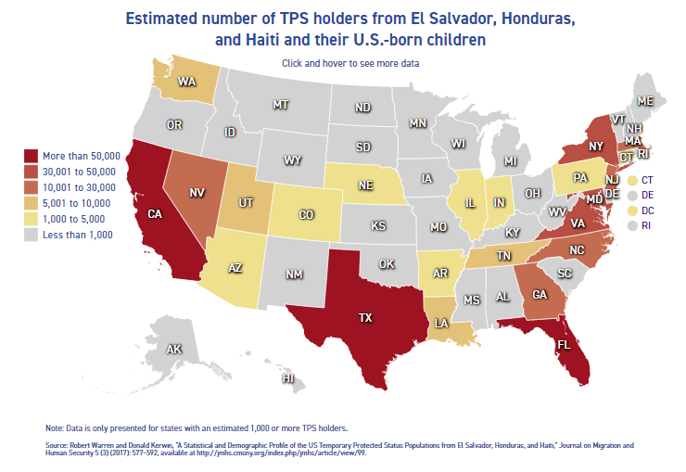
TPS Holders in Texas
44,800 TPS holders in Texas are from El Salvador, Honduras, and Haiti
53,800 U.S.-born children in Texas have parents from El Salvador, Honduras, and Haiti who have TPS
$2.2 billion annual loss in state GDP without TPS holders from El Salvador, Honduras, and Haiti
Notes:
Spread out in the U.S., but their numbers are concentrated in three major states, Texas, California, and Florida
TPS holders in Texas play an outsized role in the state’s construction industry. Thousands of Salvadoran and Honduran TPS holders in the state work in construction, contributing significantly to an industry that was facing a worker shortage even before demand for construction picked up after the hurricane.
TPS holders in Texas are also long-time members of their communities. The nearly 45,000 Salvadoran and Honduran TPS holders in the state have lived in the country for an average of 20 years and hold an estimated 13,000 mortgages that would be jeopardized if their work authorization is allowed to expire.

Slide 8
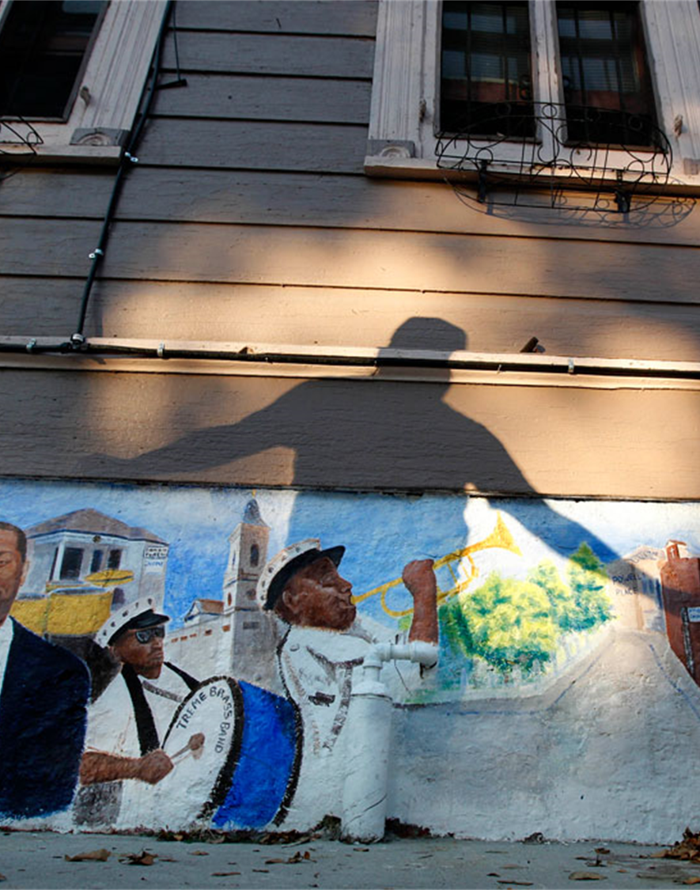
The Effects of Sanctuary Policies on Crime and the Economy By Tom Wong
Sanctuary counties have lower crime rates than comparable nonsanctuary counties.
Local economies are stronger in sanctuary counties compared to nonsanctuary counties.
Sanctuary counties are keeping families together, strengthening local economies.
Notes:
Early 2016, we published a report on sanctuary cities with Tom Wong
Statistical analysis illustrates that across a range of social and economic indicators, sanctuary counties perform better than comparable nonsanctuary counties.
Some points to highlight from the report:
- There are, on average, 35.5 fewer crimes committed per 10,000 people in sanctuary counties compared to nonsanctuary counties.
- Median household annual income is, on average, $4,353 higher in sanctuary counties compared to nonsanctuary counties.
- The poverty rate is 2.3 percent lower, on average, in sanctuary counties compared to nonsanctuary counties.
- Unemployment is, on average, 1.1 percent lower in sanctuary counties compared to nonsanctuary counties.

Slide 9
The Negative Consequences of Entangling Local Policing in Immigration Enforcement
LAPD: 2016 → 2017, Latinos reported rape ⬇️ 25%; spousal abuse ⬇️ 10%
Houston: Q1 2016 → Q1 2017, Latinos reported rape ⬇️ 43%; non-Latinos ⬇️ 8.2%
Philadelphia, Denver: Q1 2016 → Q1 2017, crime reports disproportionately ⬇️ for Latinos, not non-Latinos
"Criminals understand that, and they will feel emboldened to commit crimes against the immigrant community without fear of being held accountable because they know they won't call police… It creates a haven for crime." (August 2017)
- Austin Police Chief Brian Manley

Slide 10
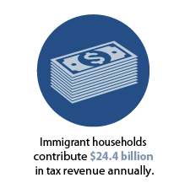
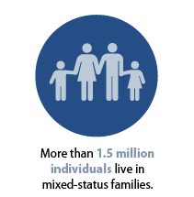
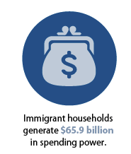
What’s at Stake: Immigrant Impacts in 287(g) Jurisdictions
25 jurisdictions in Texas have 287(g) agreements
Among jurisdictions analyzed:
Tarrant County has the largest foreign born population with 307,600 residents.
Immigrant households pay $2.5 billion in taxes and have a spending power of $7.4 billion.
Nearly 250,000 residents live in a mixed status family
Notes:
Often when the issue of immigration comes up people think of it narrowly, focusing on how the policies that we adopt could affect immigrants themselves.
A question that receives far less attention is how the policies that we adopt affect all of us. There are an estimated 11 million undocumented immigrants living in the country today, but more than 16.7 million people live in the same household as at least one undocumented family member. Within these families there are nearly 6 million U.S. citizen children.
Texas has a population of 26.2 million people. More than 1-in-10 of all Texans is part of a mixed-status family. That’s second only to California.
This year we released an analysis on 40 jurisdictions with 287g agreements (immigration enforcement partnership with ICE()
Key Points:
- Immigrants make substantial contributions to their communities.
- Communities should consider the impact of local police deciding to work with immigration enforcement.
- Participation in 287(g) agreements could have severe consequences for communities considering the program.

Slide 11
Sources:
Center for American Progress, "Removing Unauthorized Workers Harms States and Industries Across the Country,” September 21, 2016, available at https://ampr.gs/2dnJyXQ
Center for American Progress, “Temporary Protected Status: State-by-State Fact Sheets,” October 20, 2017, available at https://ampr.gs/2gqmd9f
Nicole Prchal Svajlenka, “What’s at Stake: Immigrant Impacts in 287(g) Jurisdictions,” March 20, 2018, available at https://ampr.gs/2qe0dUg
Ryan D. Edwards, Francesc Ortega, “The Economic Impacts of Removing Unauthorized Immigrant Workers: An Industry- and State-Level Analysis,” Center for American Progress, September 21, 2016, available at http://ampr.gs/2cXm9NQ
Ryan D. Edwards, Francesc Ortega, and Philip E. Wolgin, “The State-by-State Economic Benefits of Passing the Dream Act,” Center for American Progress, October 26, 2017, available at http://ampr.gs/2xqfgMj
Tom K. Wong and others, “DACA Recipients’ Economic and Educational Gains Continue to Grow,” Center for American Progress, August 28, 2017, available at http://ampr.gs/2vwDl2Z
Tom K. Wong, “The Effects of Sanctuary Policies on Crime and the Economy,” Center for American Progress, January 26, 2017, available at https://ampr.gs/2kxOcHX

