Slide 1
The bar exam is coming.
You can do it!

Slide 2
Bar Exam Dates
Texas: July 30-31, & Aug 1, 2019
New York (UBE), California and all UBE States: July 30-31, 2019
  NY has a separate, state specific online course and online exam in addition to the two day UBE
  Application takes about 30 minutes; NY does character and fitness after the exam.
  Check your jurisdiction’s rules to make sure that you are compliant.

Slide 3
Application Deadlines
Texas
  February 1 was on time
  Late deadline: April 1 ($150 late fee)
  Final Deadline: May 1 ($300 late fee)
New York
  April 1 – 30, 2019 (no provisions for late filing)
California
  March 1-April 1 is on time
  Final Filing Deadline: June 3 ($250 late fee)
Disability accommodations

Slide 4
Texas Bar Exam – 2.5 days
Day One
  90 minute TX Civil and Criminal Procedure and Evidence (short answer)
  90 minute Multistate Performance Test (two MPTs on UBE)
    Closed universe exam. Practice.
Day Two
  Multistate Bar Exam – two sessions, three hours each. All multiple choice. All jurisdictions except LA.
    All 1L subjects (Con Law, Civ Pro, Contracts, Crim Law, Property and Torts) + Criminal Procedure and Evidence
    1.8 minutes per question
Day Three
  Twelve Texas Essays – two sessions, three hours each.
    Each essay takes approximate 30 minutes.
    Wills, BA, Family Law, UCC (Secured Credit, Comm Paper), Real Property (including Oil & Gas), Consumer Protection, Trusts/Guardianship

Slide 5
Other states
California Bar Exam
  Two days – Five 1 hour essays, one MPT, MBE
Uniform Bar Exam
  NY, NJ, MA, CO, WA, OR and 28 more
  Two days;
    Day 1 is MBE
    Day 2
      2 MPTs
      Multistate Essay Exam (MEE)
        Six 30-minute mixed subject essays

Slide 6
Scoring
Texas
  Need 675 of 1000 to pass
    MPT is 10%
    Short answer is 10%
    MBE is 40%
    TX essays are 40%
  UBE states
    MPT (2) is 20%
    MEE is 30%
    MBE is 50%
    Cut scores for the UBE vary by state. NY is 266; AK is 280; NM is 260

Slide 7
Let’s talk about the MBE.
Beware older questions.
PRACTICE.
Sample question*:
A young man suggested to his friend that they steal a large- screen TV from a neighbor’s house. The friend was angry with the young man and decided to use the opportunity to get even with him by having him arrested. The friend said he would help, and that night, he drove the young man to the neighbor’s house. The young man broke in while the friend remained outside. The friend called the police on his cell phone and then drove away. Police officers arrived at the scene just as the young man was carrying the TV out the back door.
The jurisdiction defines crimes as at common law.
Of what crime, if any, can the friend properly be convicted?
(A) No crime.
(B) Conspiracy.
(C) Burglary.
(D) Conspiracy and larceny.
*copyright NCBE
Notes:
No proper names. Only four options. Can be MUCH longer.

Slide 8
So what is my summer actually going to be like?*
Typical bar course format
  Time Spent
    33% lectures
    18% doing MC practice
    17% practice essays
    17% review notes/outlines
What do you really have to do?
  Simulated MBE: DO IT
How long should I study?
  Peak day is typically 8.5 hours
  Less than 2-3 hours per day is the difference between passers and those unsuccessful
  Weekends you take off. Still be you.
Remember, you paid to do this.
*Statistics from BarBri

Slide 9
What to do NOW.
Participate in the Bar Exam Skills and Training workshop.
  Three week course on bar essay writing skills
  Tuesday or Thursday at noon; no work outside of each 1 hour session.
Buy your prep class
  Funding available through employers, private loans.
  Public interest focused students should ask for a discount.
  Scholarships.
Prepare your friends and family.
Get everything in place for summer so you don’t have to worry about anything else.
  Arrange for child care (if needed)
  Decide where you will live/study
    You should change it up in study spaces!
Think carefully about toxic habits and/or people in your life.
  Try to clean it up now.

Slide 10
Find your Fight Song.

Slide 11
During Summer Prep
Bar class will likely start after exams but before the Sunflower Ceremony (Themis and Kaplan do; BarBri likely).
Everything your bar prep company tells you to. SERIOUSLY.
Start memorizing early.
Give yourself work hours; be flexible.
  Typical day includes lecture, review, practice essays, practice MBE
Do questions under time restrictions; bar takers are often surprised by how quickly the time goes.
Be a person.
Stop by the law school for our bar study pizza lunches!

Slide 12
Pass v. Fail
Passers spent, on average, 433 hours studying
Those who failed spent 349 hours.
Knowledge is power.

Slide 13
Average Estimated Daily TIME (IN HOURS) for COMPLETED Assignments by Assignment Category
TEXAS – Comparison (from BarBri)
Passed
Did not pass
Passers did the following:
More time on lectures
Took mock MBE seriously
Spent much more time on MBE practice
This dip is a problem. This is the weekend before the exam.

Slide 14
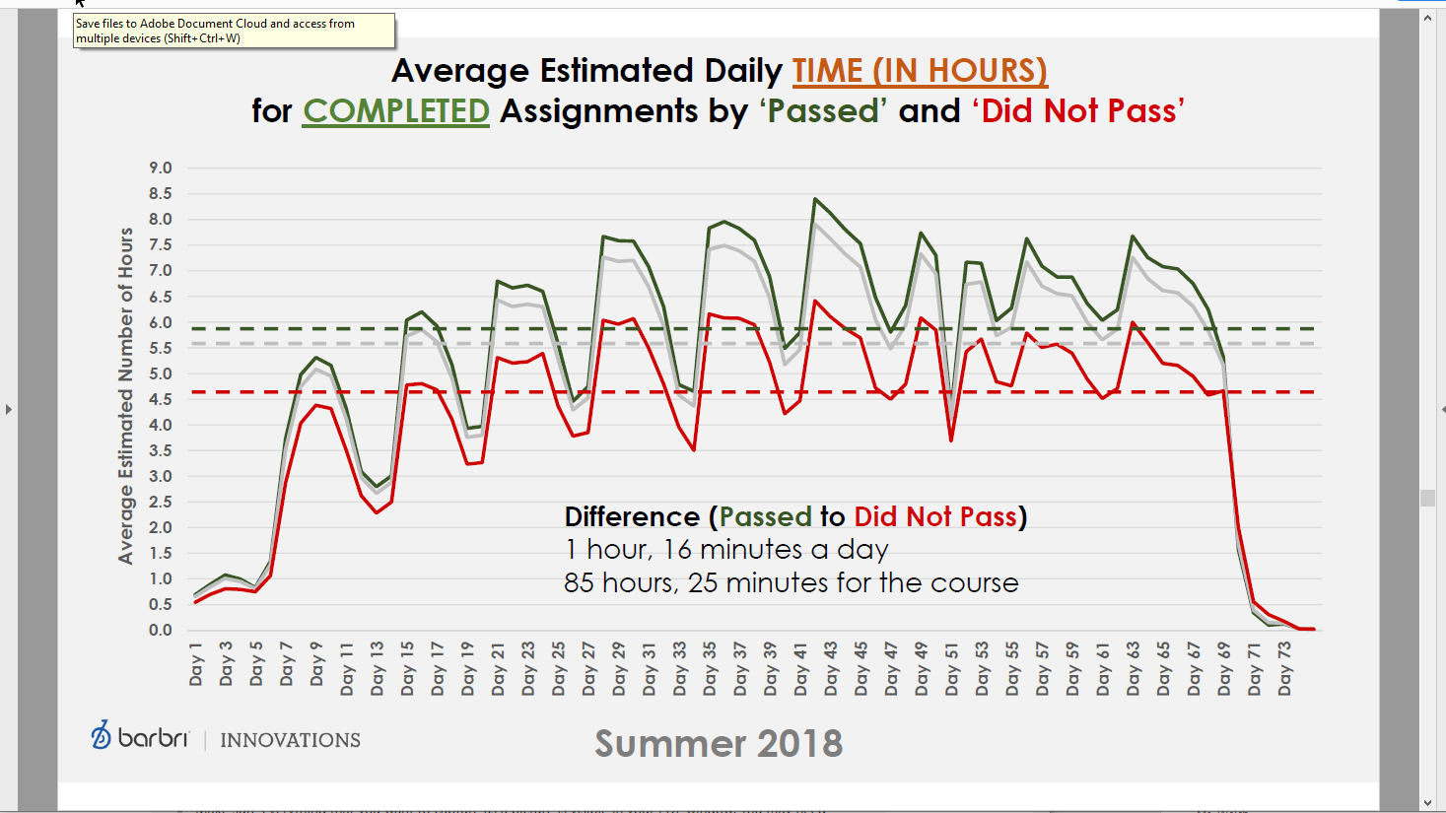

Slide 15
What about those supplemental courses?
PMBR, Adaptibar, etc.
Critical Pass flashcards
Released questions from the NCBE (National Conference of Bar Examiners)
Optional P&E session

Slide 16
This will be you.
https://www.youtube.com/watch?v=SH-w9OD7LlI

Slide 17
Let’s talk to some successful bar takers.
Make it real.

