Slide 1
You can do this!
Professor Amy Newcomb Seton Hall University School of Law
Surviving law school in uncharted territory.

Slide 2
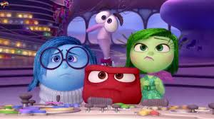
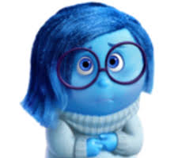
Feel the feelings.
Grief is good: ted talk
https://www.youtube.com/watch?v=snbc6jg0Oro
Notes:
It’s normal to feel sad, anxious, frustrated, angry, disgusted etc.

Slide 3
Remind yourself why you’re doing this.
z

Slide 4
Try not to worry about being behind …
z
Notes:
I hear experts advising us to focus on what we can control, so the rest of this presentation centers on those things.

Slide 5
Make a reasonable to do list for today; for example:
Review notes from today’s class
Do one practice question
Read for tomorrow
Notes:
If you want to write a longer more complete list, call it an activity inventory, and select your daily to do items from there.

Slide 6
Productivity: decide where you can work.

Slide 7
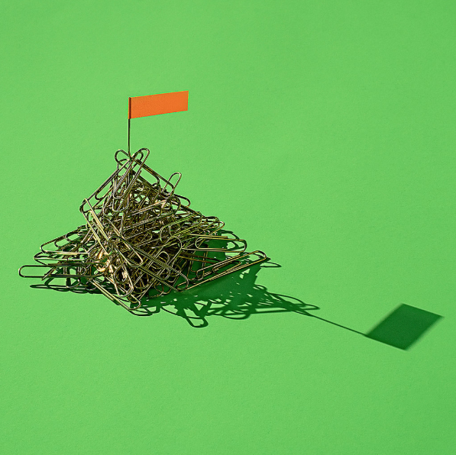
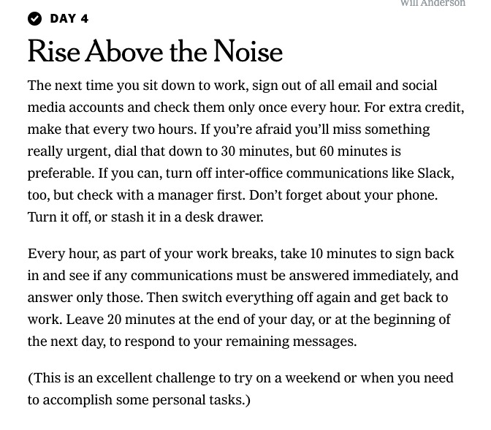
Productivity: rise above the noise.
Notes:
I recommend the New York Times Be More Productive Challenge; consider taking it over the next seven days.

Slide 8
Does your music distract or keep you on track?
https://www.foundationeducation.edu.au/articles/2018/07/does-music-help-study#:~:text=Yes%2C%20music%20can%20create%20a,focus%20during%20long%20study%20sessions.&text=Relaxing%20music%20for%20studying%20can,you%20beat%20pre%2Dexam%20anxiety.
Notes:
Sarah MacLauchlan is my background work music while my daughter listens to Broadway. My husband can work with ESPN on in the background; my son was blasting Seems Like Teen Spirit; you have to identify what works for you, and stick with it—or with nothing.

Slide 9
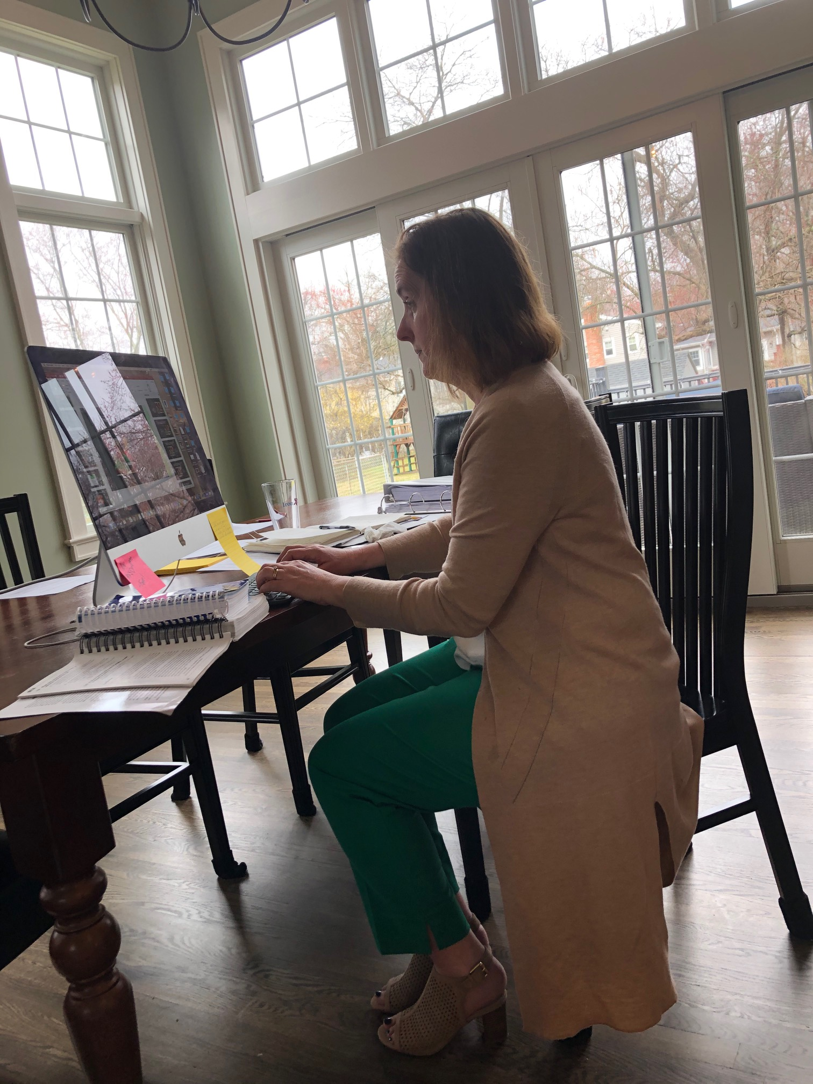
Productivity: signal to others you’re in deep work.

Slide 10
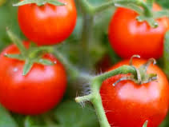
Productivity: smash those tomatoes.
http://mytomatoes.com/
A nice goal is four 25-minute segments of deep work with 4-minute breaks followed by one longer break.
Do what you can:
73 mins on 17 mins off
start with 10 on 1 off

Slide 11
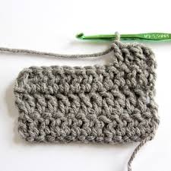
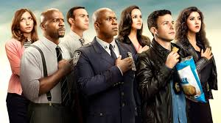
Treat yourself. https://gretchenrubin.com/2017/03/healthy-treats-give-yourself
Notes:
Healthy treats function differently than rewards and differently than binging.

Slide 12
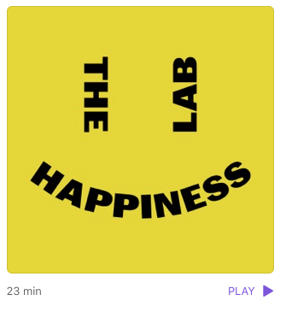
Remember that you learn best when you feel rested, happy, interested, and safe.
Prepared for you by a professor of psychology at Yale.
https://podcasts.apple.com/us/podcast/coronavirus-bonus-beat-your-isolation-loneliness/id1474245040?i=1000468548405

Slide 13
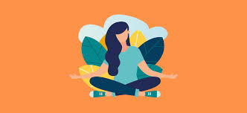
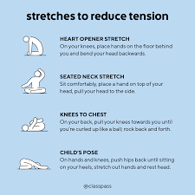
Manage your own physical stress response. Try exercise, yoga, prayer, breathing.

Slide 14
Do a practice exam.
We are returning to this Blackboard space to group up and review the answers to your Property or Contracts professor’s most recent archived exam at 4:30 Saturday, March 21.
Hope you can join us!

Slide 15
Review good resources on my Blackboard org.
Or wherever you keep your good things . . . .

Slide 16
Reach out if you need specific help.
Add your school contacts

